Slide 1

STUDENT MANAGEMENT SYSTEM
Created By:
Kushal Kc
Mala Thapa Magar
Namkong Hang Kirat
Neha Adhikari

Slide 2
PROJECT ABSTRACT
Introduction
Features
Objectuves
Algorithm
Flowchart
Implementation
Expected I/O
Enhancement and Conclusion
Drawbacks

Slide 3
INTRODUCTION
Student Management System is a simple console application, developed using C programming language. And some texts.
It is an automated version of manual Student Management System
This mini project utilizes various aspects of the C language such as functions, arrays, pointers, file handling, and data structure.

Slide 4
FEATURES
Adding records
Searching record
Modifying records
Deleting records
Exiting the Program

Slide 5
OBJECTIVES

Slide 6
Allow the administrator to manage the student’s information during admission or examination.
THE BASIC
OBJECTIVES
Utilize human resource more efficiently.
To reduce unnecessary paper work in maintaining student’s information.

Slide 7
ALGORITHM
Step1: Start
Step2: print created by:---
Step3: create switch(choice)
Step4: Input number for choice
Step5: is choice==1?
-if yes, print add record
-Open a file *fp="record.txt"
Is fp==NULL?
-if yes,print error to open file
-if no,input stu.id,stu.name,stu.address,
stu.parname,stu.phone_no
Step6: is choice==2?
-if yes,print search record
-input s_id
-Open "record.txt"
Is s_id==stu.id?
-if yes, print record found
-Print stu.id,stu.name,stu.address,
stu.parname,stu.phone_no
-if no,print no record found

Slide 8
ALGORITHM
Step7: is choice==3?
-if yes,print modify record
-Open "record.txt"
-Input s_id
-Is s_id==stu.id?
-if yes, input stu.id, stu.name, stu.address, stu.parname, stu.phone_no
-if no,print no record found
Step8: is choice==4?
-if yes,print delete record
-Open "record.txt “
-Input s_id
Is s_id==stu.id?
-if yes, delete record
Step9: is choice==5?
goto step 10
Step10: stop

Slide 9
FLOWCHART
Start
Print
Created By:--
Create Switch (Choice)
Input number for choice
Choice==1
Print Add Record
Open “record.txt”
Input Record
Choice==2
Print Search Record
Open “record.txt”
Search Record
A
B

Slide 10
FLOWCHART
A
B
Choice==3
Print Modify Record
Open “record.txt”
Modify Record
Choice==4
Print Delete Record
Open “record.txt”
Delete Record
Choice==5
Stop

Slide 11
IMPLEMENTATION

Slide 12
HEADER FILES
A header file is generally used to define all of the functions, variables and constants contained in any function library might be used.
Various header files are to be used in order to make this program usable.
Header Files used:
#include <stdio.h>
#include <conio.h>
#include <string.h>
#include <stdlib.h>
#include <ctype.h>

Slide 13
WHAT IS UNDER EACH HEADER FILES?
#INCLUDE <STDIO.H>
fclose (Close File)
fopen (Open File)
fflush (Flush File Buffer)
fprintf (Formatted File Write)
gets (Read String)
puts (Print a string)
#INCLUDE <CONIO.H>
clreol (clears end line)
#INCLUDE <STRING.H>
strlen (For String Length)
strcpy (For copying string)
Strcmp (for comparing string)
#INCLUDE <STDLIB.H>
exit (Exit from Program)
#INCLUDE <CTYPE.H>
isalpha (Checks whether the character is alphabet)
Isdigit(Checks whether the character is digit)

Slide 14
CONTROL STATEMENT & LOOP
Control statements enable us to specify the flow of program control; ie, the order in which the instructions in a program must be executed. Hence, various control statements shall be used for this project. Various header files are to be used in order to make this program usable.
Control Statements used:
If statement
Switch Statement
Loops used:
For loop
While loop
Do-while loop

Slide 15
EXPECTED INPUT/OUTPUT

Slide 16
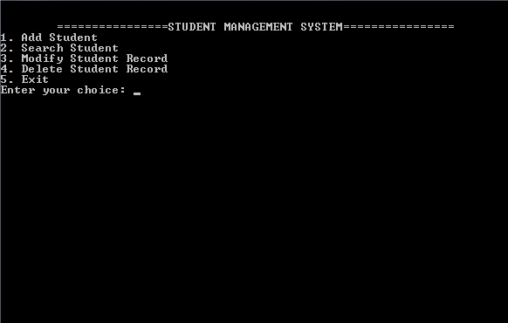
Place your screenshot here
HOME PAGE

Slide 17
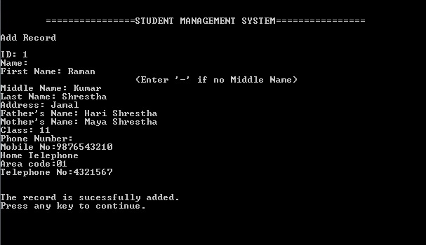
Place your screenshot here
ADDING RECORD

Slide 18
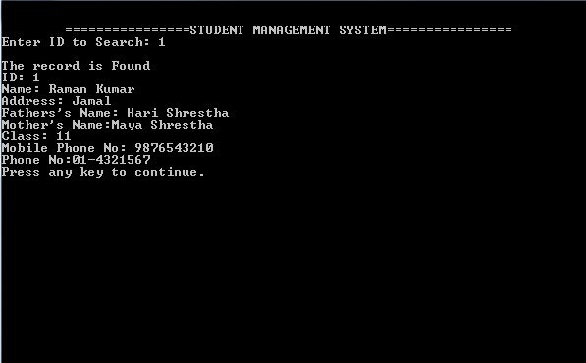
Place your screenshot here
SEARCHING RECORD

Slide 19
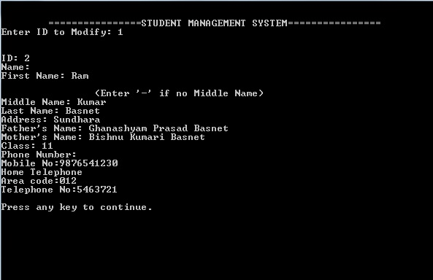
Place your screenshot here
MODIFYING RECORD

Slide 20
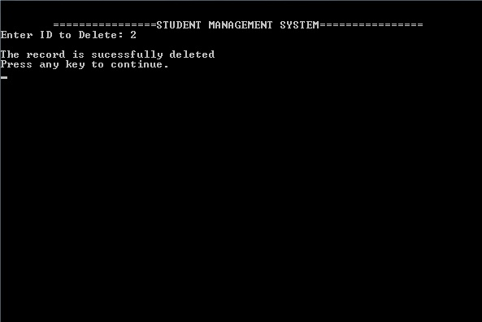
Place your screenshot here
DELETING RECORD

Slide 21
CONCLUSION
The existing system only provides text-based interface, which is not as user-friendly as Graphical user Interface.
Since the system is implemented in Manual, so the response is very slow.
The transactions are executed in off-line mode, hence on-line data capture and modification is not possible.
We don't have the secure system now i.e. our system is not protected against the anonymous user.
The program is still not capable of editing and deleting records, but it shall be included in the whole project.

Slide 22
DRAWBACKS
The existing system only provides text-based interface, which is not as user-friendly as Graphical user Interface.
Since the system is implemented in Manual, so the response is very slow.
The transactions are executed in off-line mode, hence on-line data capture and modification is not possible.
We don't have the secure system now i.e. our system is not protected against the anonymous user.
The program is still not capable of editing and deleting records, but it shall be included in the whole project.

Slide 23
Thank You!
Any Questions?

